Slide 1
LYCEE DES MÉTIERS HEINLEX
FRANCE
PROJECT NR 2022-1-RO01-KA121-VET-000054070
Date : 16.01.2023-03.02.2023
Date : 18-06-2023 to 01-07-2023
Project nº: 2021-1-FR01-KA121-VET-000011150

Slide 2
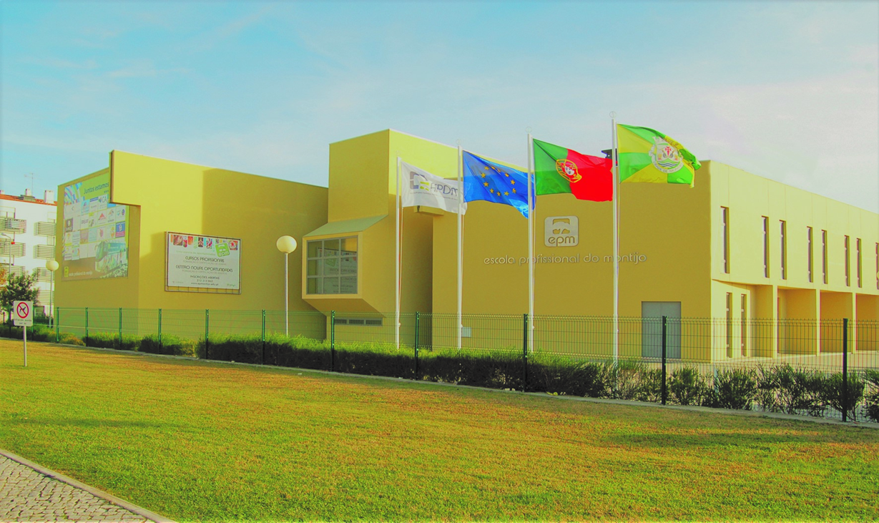
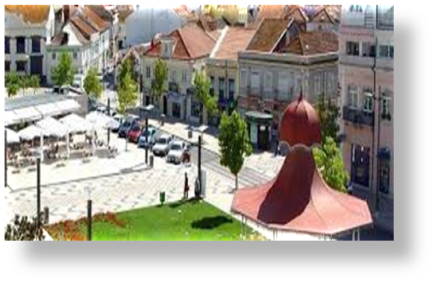
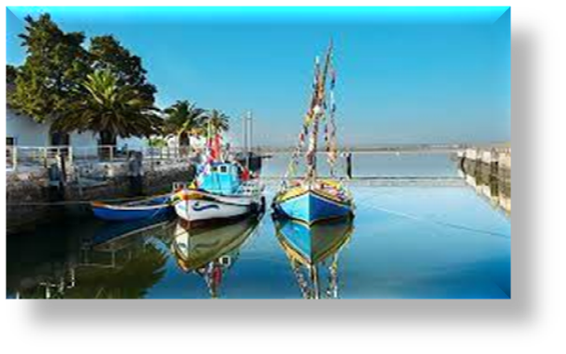
Monday 19th of June
10:30 Welcome meeting and presentation at Vocational School of Montijo
13:00 Lunch Epm Rest.
16:30 Presentation to Ligia Garrido - Atelier LM's
19:00 Dinner Epm Rest.

Slide 3
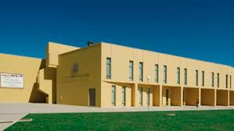
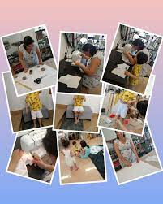
Work Programme
20th of June to 30th of June
Monday to Friday
EPM
Ligia Garrido - Atelier LM's

Slide 4
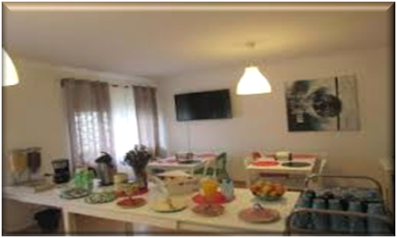
Meal Programme Local
Breakfast
07:30 Casa Europa
Lunch
13:00 Epm Restaurant
Dinner
19:00 Epm Restaurant
Cultural Visit
Take away

Slide 5
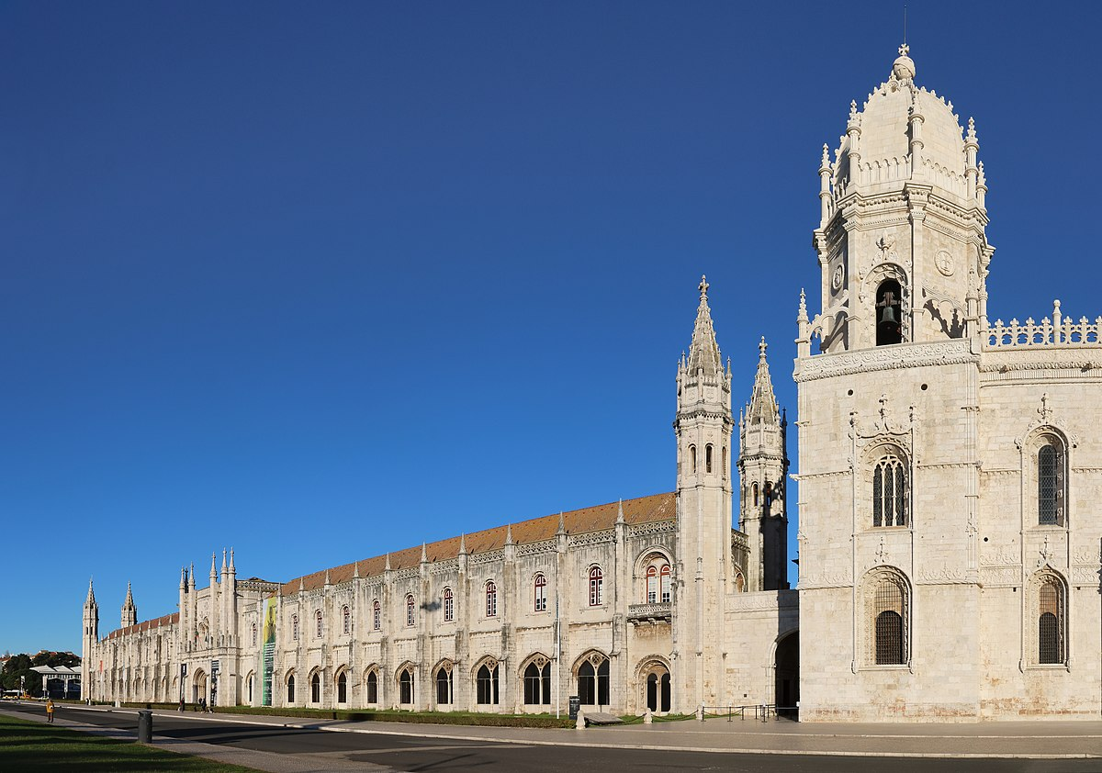
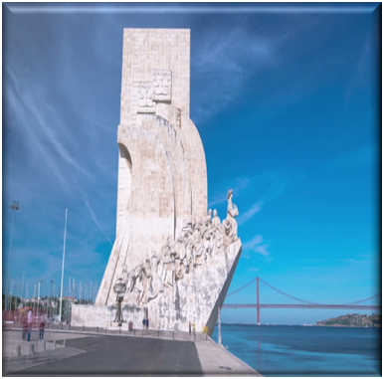
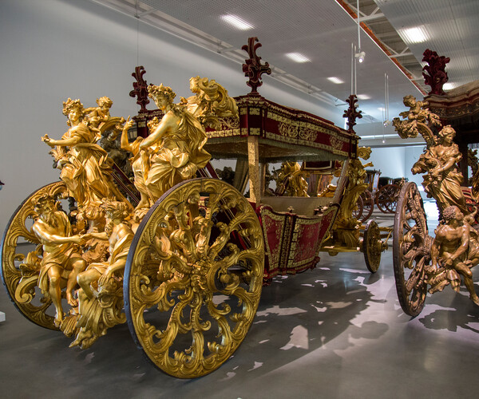
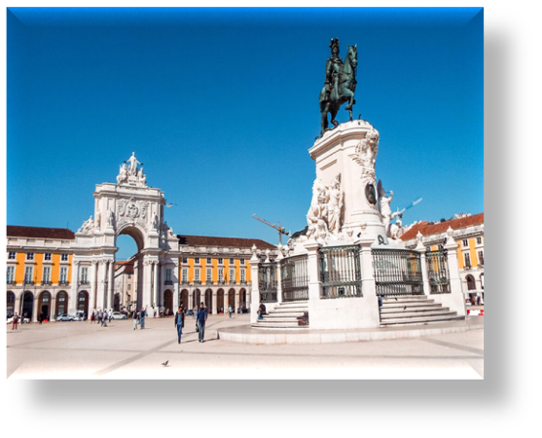
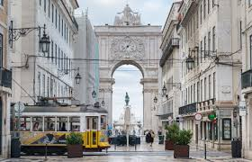
Sunday 25th of June
JERONIMOS MONASTERY
DISCOVERIES MONUMENT
09:30 Departure
Jerónimos Monastery
Discoveries Monument
National Coach Museum
Lunch Take away
Commerce Square Lisbon
19:00 Dinner Epm Rest.
NATIONAL COACH MUSEUM
BELÉM PASTRY SHOP

Slide 6
27th of June to 03rd of July
Leia abaixo ou clique AQUI para conhecer o programa!!

Slide 7
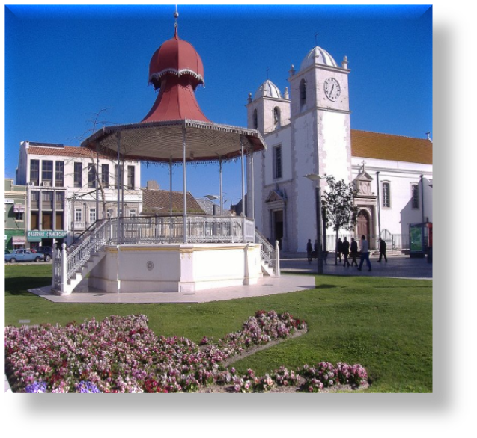
Montijo Is located in district of Setubal in Lisbon Greater Metropolitan Area. It has total population of 57 543 inhabitants.
The Vasco da Gama Bridge connects Montijo to Lisbon over the huge Tagus river.

Slide 8
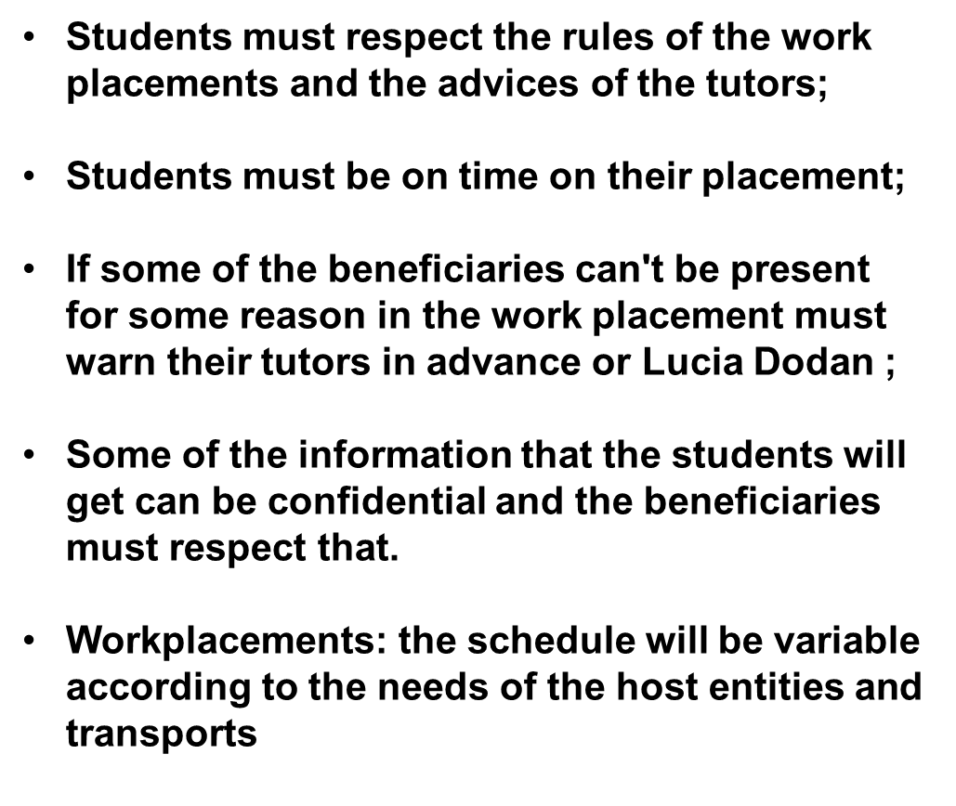
Workplace Rules

Slide 9
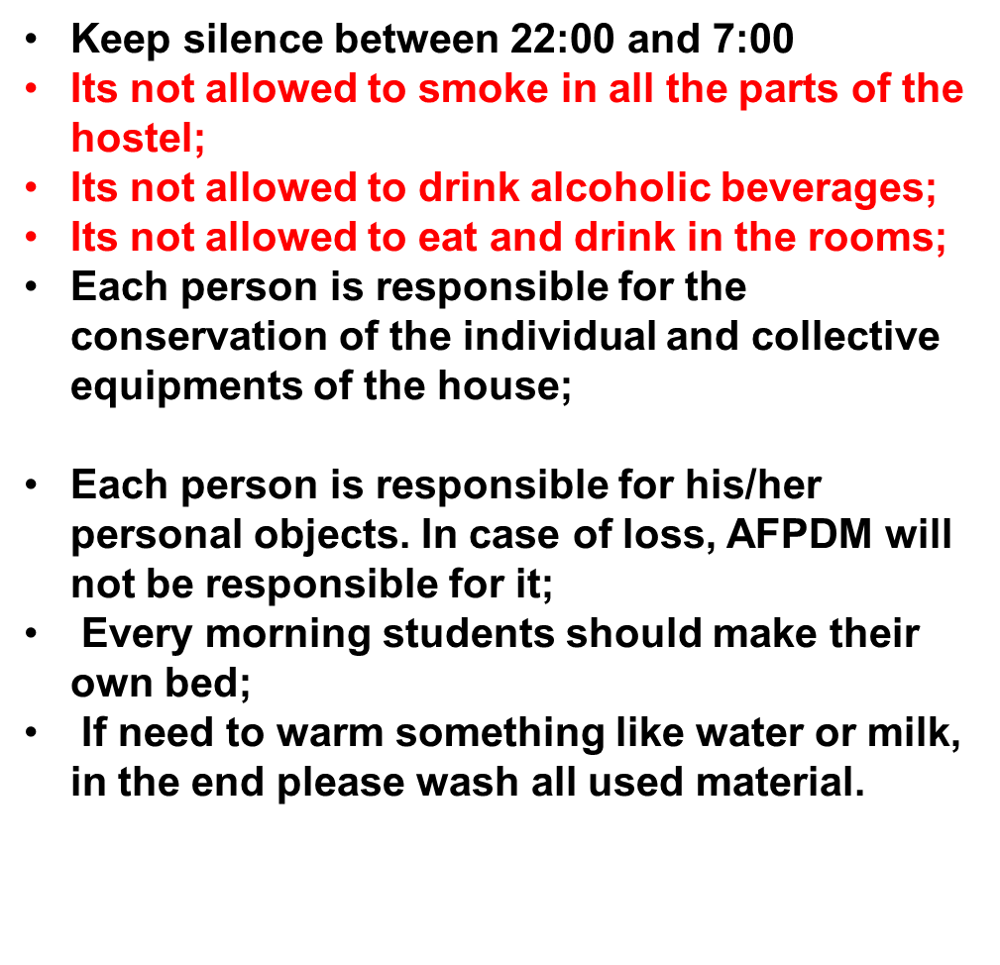

Slide 10
A.F.P.D.M. /EPM
Paula Heitor Mobile (+351)933 929 687 E-mail : projetosinternacionais@epmontijo.edu.pt
Lucia Dodan Mobile (+351)918 724 243 E-mail : lucia.dodan@epmontijo.edu.pt
João Martins Mobile(+351)912 266 114 E-mail : joão.martins@epmontijo.edu.pt
Emergency number: 112
Montijo Hospital: (+351) 212 310 046 / ( +351) 212 309 100
Montijo Police: (+351) 212 310 144
Taxis: (+351) 212 310 025

